Slide 1
P3-Hnefatafl
-Party A
Members(A-Z):
Emmett BeAney, Jacinda Li , Nana Yin

Slide 2
The perfection of documents
1. User stories
2.CRC card & class diagram
3.Acceptance Criteria
4. Task for User stories
5. Development Manual

Slide 3
User Stories

Slide 4

User Stories
• As a user, I want to invite another user who is online to start a game.
Priority:6
• As a user, I want the user who is invited to a game to be able to either accept or ignore.
Priority:7
• As a user, I want to have rules and tutorials before I start playing the game for the first time.
Priority:8

Slide 5
User Stories
• As a user, I want to be able to quit from any game of Hnefatafl at any time.
Priority:9
• As a user, I want to be able to view the history of previous games including
the result of the game and the opponent.
Priority:10

Slide 6
Task for User Stories
•As a user, I want to invite another user who is online to start a game. （Finished）
Task:
1.Write code to search players in the front end
2.Write code to implement find users in the back end
3.Write code to implement the invitation sending screen
4.Write code to implement the function of add invitation in the back end

Slide 7
Task for User Stories
• As a user, I want the user who is invited to a game to be able to either
accept or ignore. （Finished）
Task:
1.Write code to implement invited prompt screen
2.Write code to search the invitation from database
3.Write code to send the information about inviter and invitee to the game board
4.Write code to implement when player accept an invitation, jump to the game board
5.Write code to remove the invitation information after rejecting the invitation in the back end

Slide 8
Task for User Stories
• As a user, I want to have rules and tutorials before I start playing the game for the first time. （Finished）
Task:
1.Write code to implement tutorial screen

Slide 9
Task for User Stories
• As a user, I want to be able to quit from any game of Hnefatafl at any time.（Finished）
Task:
1.Write code to quit prompt screen
2.Write code to implement the quit button and the return button
3.Write code to jump back to the login screen

Slide 10
Task for User Stories
• As a user, I want to be able to view the history of previous games including the result of the game and the opponent.
(finished)
Task:
1.Write code to save the result into database.
2.Write code to implement show the result to the front end.
3.Write code to implement search the result from the database.

Slide 11
CRC Cards &
Class Diagram

Slide 12
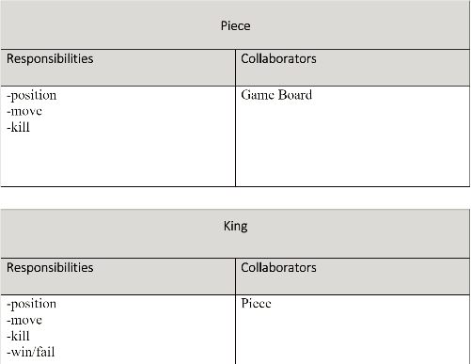
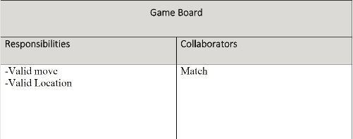
CRC Cards &Class Diagram

Slide 13
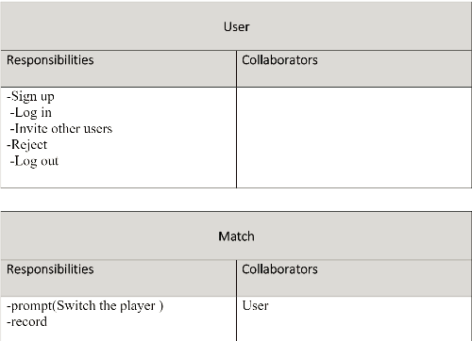
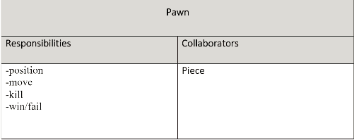
CRC Cards &Class Diagram

Slide 14
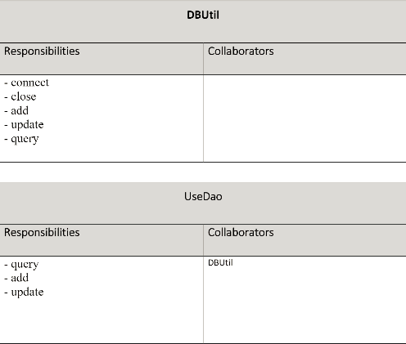
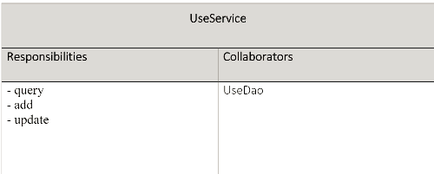
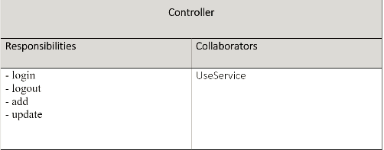
CRC Cards &Class Diagram

Slide 15
Traceability link matrix
 | GameBoard | Piece | King | Pawn | Match | User | LoginServlet | LogoutServlet | AddUserServlet | UserService | UserDao | DBUtil
#16 Add registration information |  |  |  |  |  |  |  |  | x
#17 Submit registration information |  |  |  |  |  |  |  |  | x
#18 Get login information from database |  |  |  |  |  |  | x |  | x |  | x | x
#19 Add registration field for user input |  |  |  |  |  |  |  |  | x | x | x | x
#25 Piece movement | x | x | x | x | x
#26 Add piece capture logic | x
#27 Determine which users turn | x |  |  |  | x | x
#31 Allow user to logout |  |  |  |  |  |  |  | x |  | x | x | x
#2 Epic: Register for platform |  |  |  |  |  | x |  |  | x | x | x | x
#3 Epic: Login to platform |  |  |  |  |  | x | x |  |  | x | x | x
#29 Display game results |  |  |  |  | x
#39 Search for other players |  |  |  |  |  |  |  |  |  | x
#41 Invite other players to play
#42 Accept invite and jump to gameboard |  |  |  |  | x | x
#45 Save game result to database |  |  |  |  | x
#46 Show the result to user |  |  |  |  | x
#47 Search result from database
#48 Search invitation from database
#49 Send invitation to gameboard
#4 Epic: I want to play Hnefatafl | x | x | x | x | x | x
#5 Epic: I want to invite others |  |  |  |  | x | x
#6 Epic: Accept or ignore an invite |  |  |  |  | x | x
#8 Epic: Send more than one invitation
#14 Epic: I want to be able to logout |  |  |  |  |  |  |  | x |  | x | x | x

Slide 16
#16 Add registration information
#17 Submit registration information
#18 Get login information from database
#19 Add registration field for user input
#25 Piece movement
#26 Add piece capture logic
#27 Determine which users turn
#31 Allow user to logout
#2 Epic: Register for platform
#3 Epic: Login to platform
#29 Display game results
#39 Search for other players
#41 Invite other players to play
#42 Accept invite and jump to gameboard
#45 Save game result to database
#46 Show the result to user
#47 Search result from database
#48 Search invitation from database
#49 Send invitation to gameboard
#4 Epic: I want to play Hnefatafl
#5 Epic: I want to invite others
#6 Epic: Accept or ignore an invite
#8 Epic: Send more than one invitation
#14 Epic: I want to be able to logout
Invitation | InviteServlet | MoveServlet | SelectInvitationServlet | SelectUserServlet | InvitationDao | MatchDao | InvitationService | MatchService | SelectHistoryServlet
 |  | x |  |  |  | x |  | x
 |  |  |  | x
x | x |  |  | x | x |  | x
 |  | x | x |  | x |  | x
 |  | x |  |  |  | x |  | x
 |  | x |  |  |  | x |  | x | x
 |  |  |  |  |  | x |  | x | x
 |  |  | x |  | x |  | x
 |  |  | x |  | x |  | x
 |  | x
x | x |  | x | x | x |  | x
 | x |  | x | x | x |  | x
 |  |  | x | x | x

Slide 17
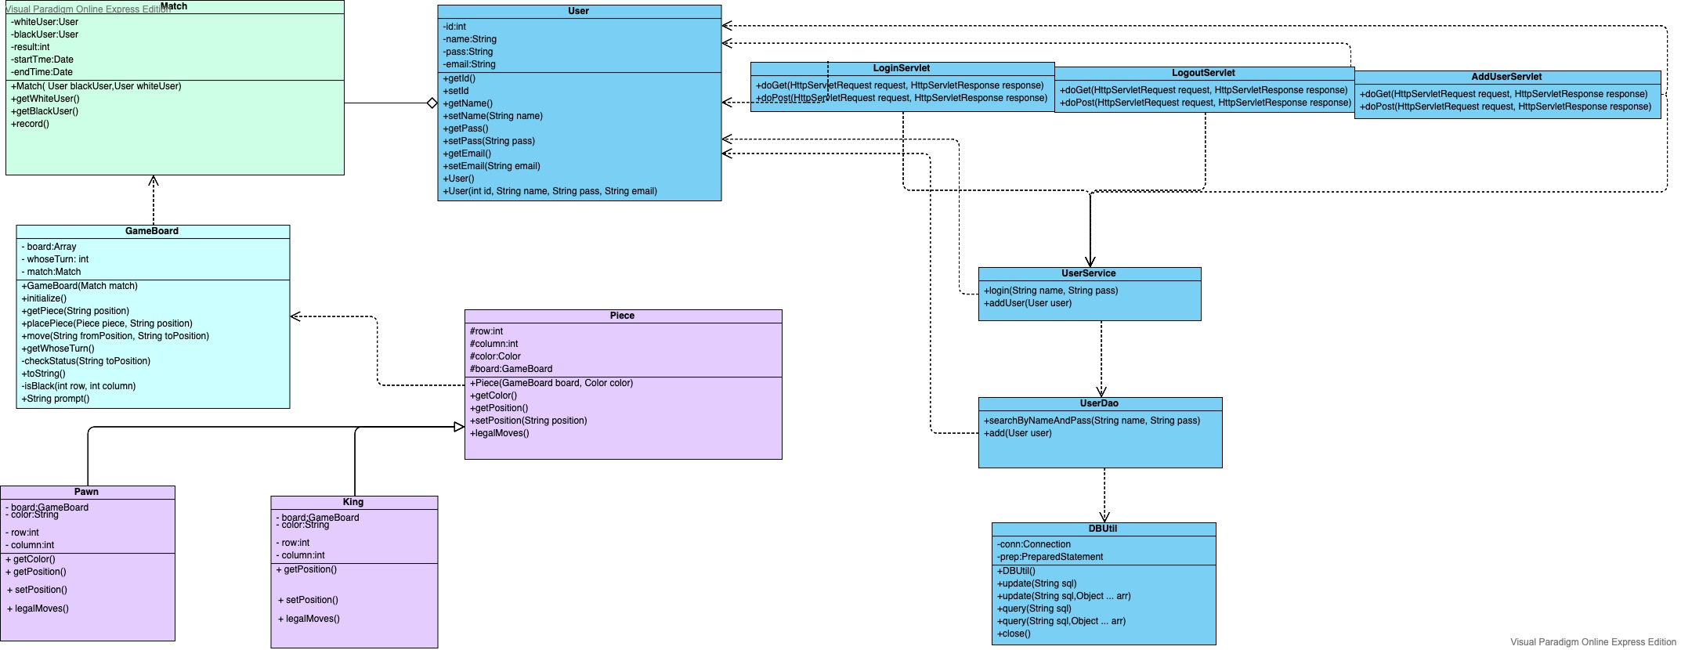
CRC Cards &Class Diagram

Slide 18
CRC Cards &Class Diagram

Slide 19
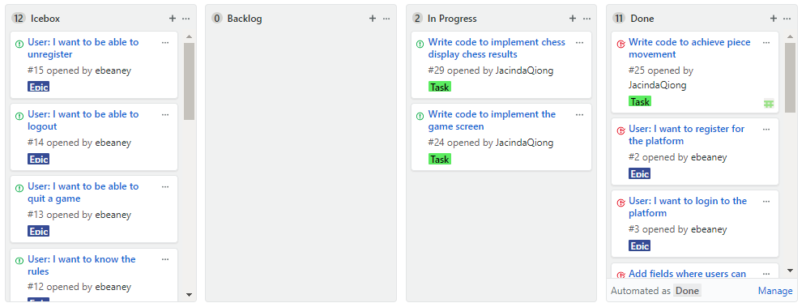
Kanban

Slide 20
Sprint Review
and Retrospective

Slide 21
Sprint Review and Retrospective
P3 (Only three people work)
11/13 | During this scrum,we went to the professor to discuss the group member problem of P2 and discussed the new task of P3. | 3 members(Nana, Emmett, Jacinda)
11/14 | During this scrum,we analyze small unfinished problems on the project, simplify them and assign them to members. | 3 members(Nana, Emmett, Jacinda)
11/27 | During this scrum,we adjusted the code and the project to complete the connection on the code. | 2 members(Nana, Emmett)
12/2 | During this scrum,we update the progress of the project and make a plan. Emmett and Nana work together to complete functions such as chess | 3 members(Jacinda, Nana, Emmett)

Slide 22
12/3 | During this scrum, Jacinda worked with Emmett to complete the invitation function. | 2 members(Jacinda, Emmett)
12/4 | During this scrum,we went to the professor's office to show the demo of P3 and explained the problem that there were only three people in the team. | 3 members(Nana, Emmett, Jacinda)
12/8 | During this scrum,we integrate the project, adjust the normal operation of the project | 3 members(Nana, Emmett, Jacinda)
P3 Review | During the whole process of 3, the group of five became a group of three, and we gradually finished the rest of the task. At the end, I showed the demo of the game to the professor and used the last time to perfect the game.

Slide 23
Sprint Review and Retrospective
What went well:
We improved the efficiency of the meeting, and actively responded to the professor when we found the members' problems.
Properly allocate your time and tasks.Try to finish the project. We strive to complete the project to the best of our ability.
What could improve:
Staff changes are too large, some members are not actively involved in the project, resulting in the project is not completed well.Early detection of personnel issues allows for better scheduling and allocation of time.

Slide 24
THANK YOU FOR WATCHING

